Slide 1


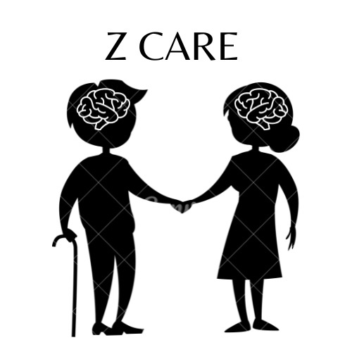
Z Care
Supervised by:
Dr. Esraa Elhariri
Dr. Asmaa Hashem

Slide 2
TABLE OF CONTENTS
03.
01.
02.
Introduction
Problem Definition
Objective and Motivation
04.
Related Work
05.
06.
Project Planning
Proposed System
07.
08.
Mobile app
Our team

Slide 3
Alzheimer
A slowly progressing, but devastating disease.

Slide 4
01.
Introduction

Slide 5
INTRODUCTION
Dementia results from a variety of diseases and injuries that primarily or secondarily affect the brain.
A person diagnosed with Alzheimer’s could suffer from various syndromes including memory efficiency decreases, speaking difficulties, lack of attention, and a decline in the quality of lifestyle.

Slide 6
55 million
10 million

Slide 7
02.Problem Definition

Slide 8
Problem Definition
Alzheimer's disease makes you alive but not.
Z care
when symptoms start to appear we face another problem which is related to the caregiver
healthcare providers have been successful in helping people.
The caregiver needs to be with the patient all the time.

Slide 9
Project objective
03.

Slide 10
Project objective
Developing an automated helpful system.
Diagnose Alzheimer’s disease in its early stages Accurately using:
Deep learning would give us the ability to
Slow the disease progression with medicine and exercises.
Maintain mental function
Make it easier for caregivers to take care of the patient

Slide 11
04.
Related Work

Slide 12
Accuracy 66.7%
Using MRI, FDG-PET, CSF, & genetic features, with Hybrid (CNN & RNN).
sMRI & fMRI data with Using ShulffleNet & PCANet.
Weiming Lin.2021
Yu Wang et al.2021
May D. Wang.2021
Zhou, P. et al. 2020
Shangran Qiu.2022
Using MRI, FDG-PET, CSF, & genetic features, with CNN.
PET and MRI images and distinguish between severity using CNN and SVM
0.78 for Accuracy
Accuracy 69.2%
Accuracy of 87%

Slide 13
Accuracy of 91 %
Accuracy of 91 %
MRI, PET & CSF data with Using SAE,DBM & SVM
using MRI data with Using autoencoder Accuracy of 91 %
fnagi.2019
Ju et al.2017
Shen et al.2019
Shen et al.2019
Hybrid model of DBN & CNN is better than traditional approaches
distinguish AD From mild cognitive impairment using PET data Using Deep Belief Network
Accuracy of 86%

Slide 14
05.
Project planing

Slide 15
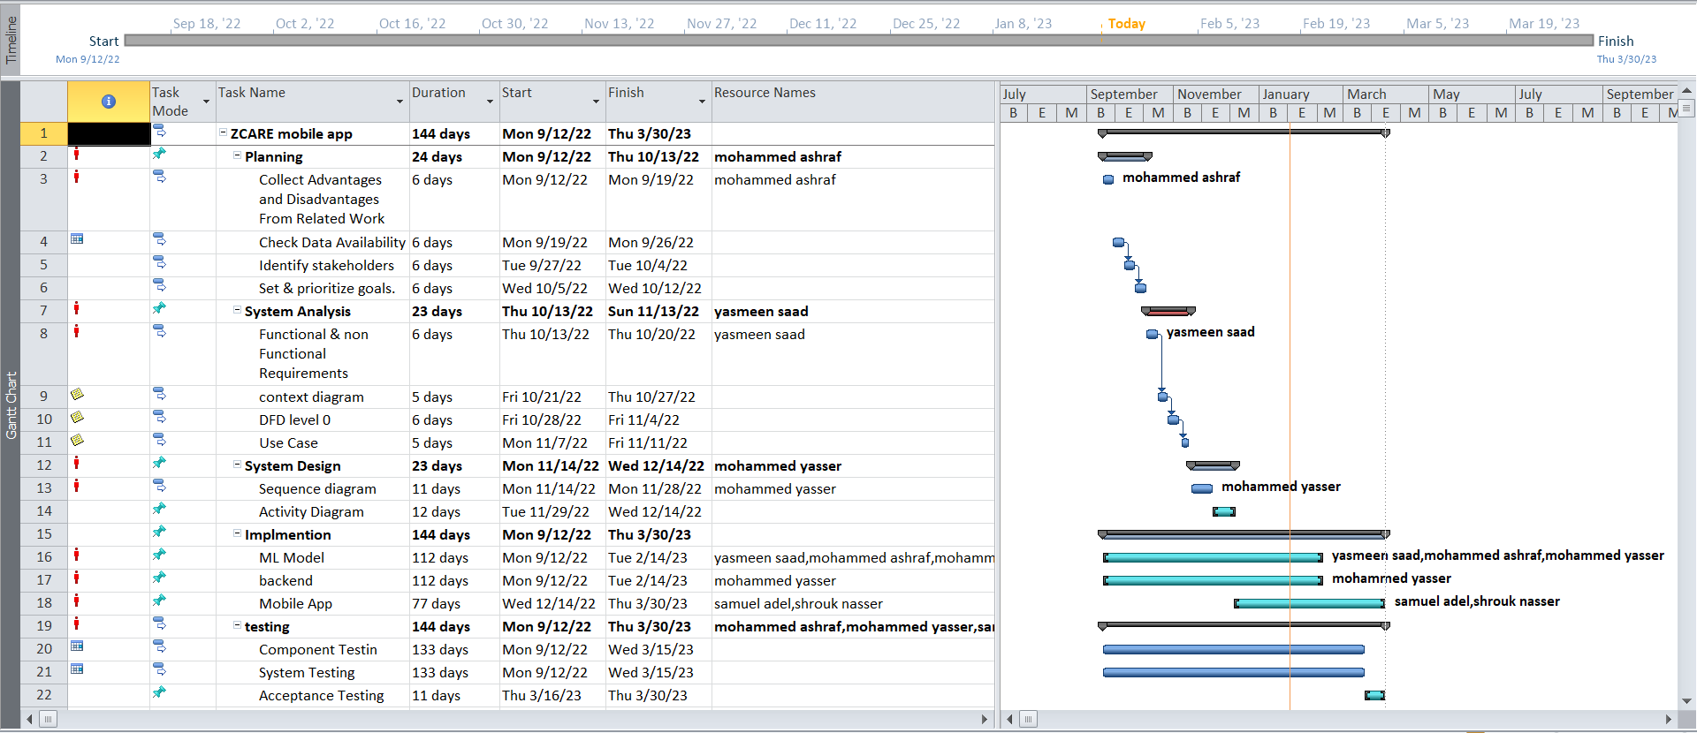

Slide 16
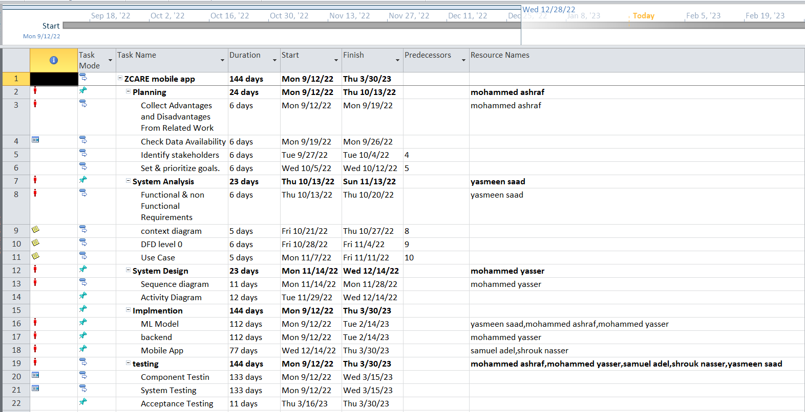

Slide 17
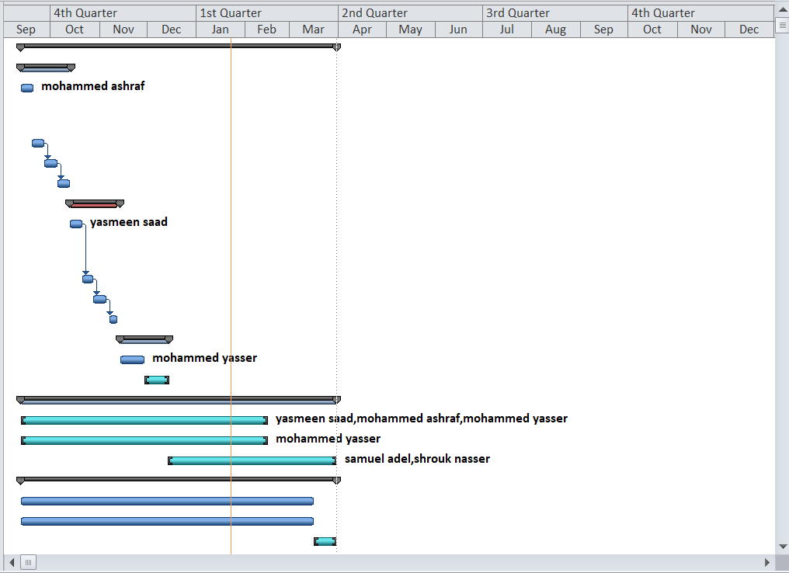

Slide 18
06.
Proposed System

Slide 19
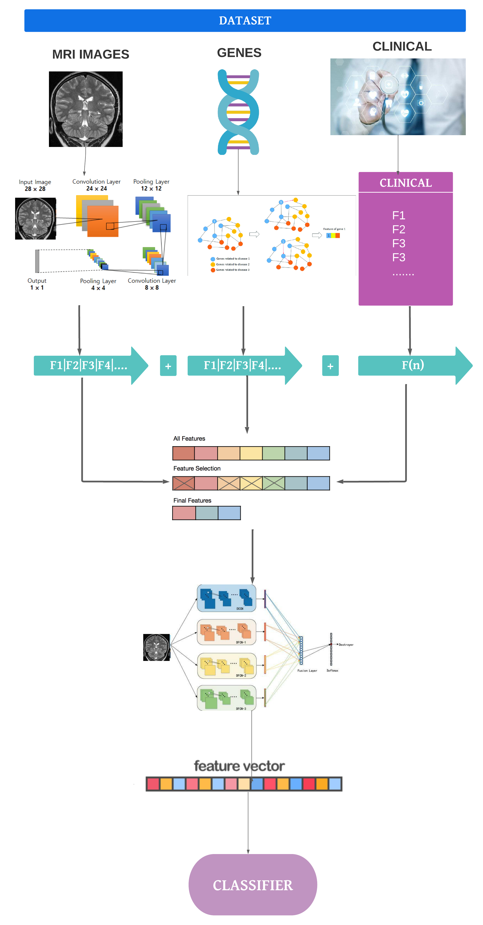
—ML Framework

Slide 20
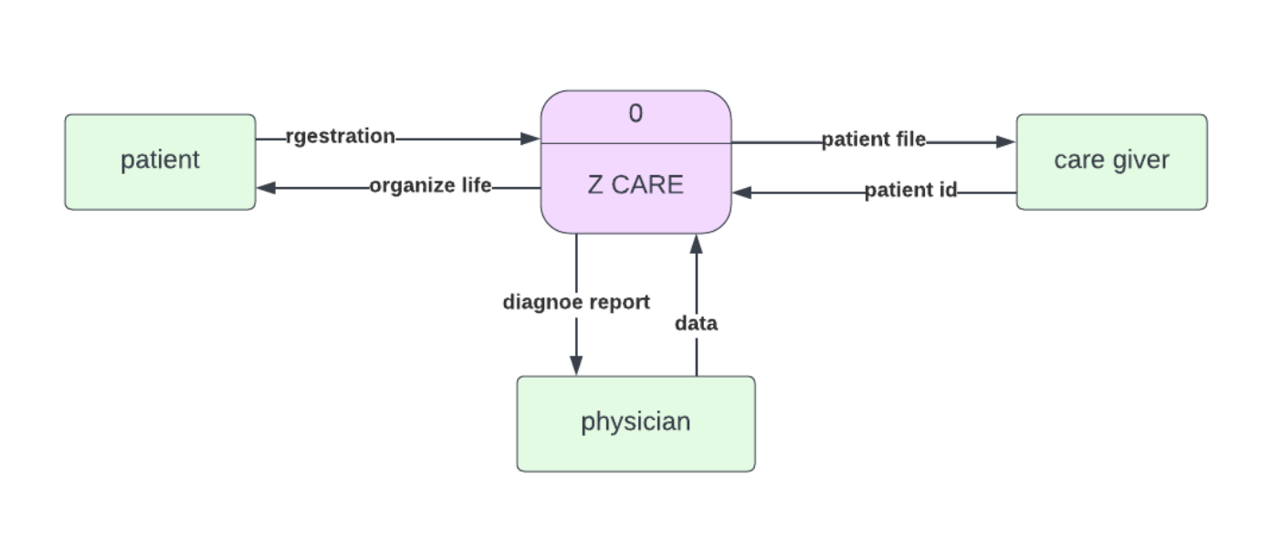
—Context Diagram

Slide 21
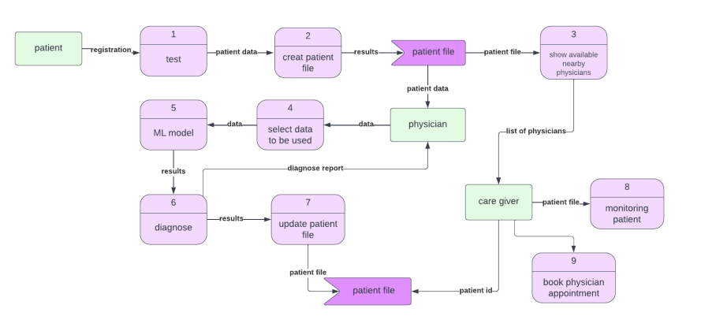
—DFD level 0 Diagram

Slide 22
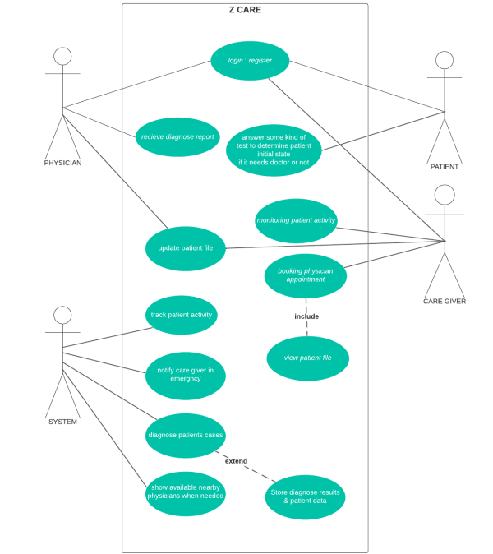
—Use Cases Diagram

Slide 23
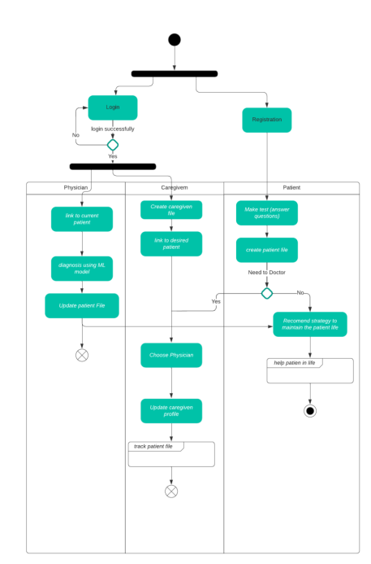
—Activity Diagram

Slide 24
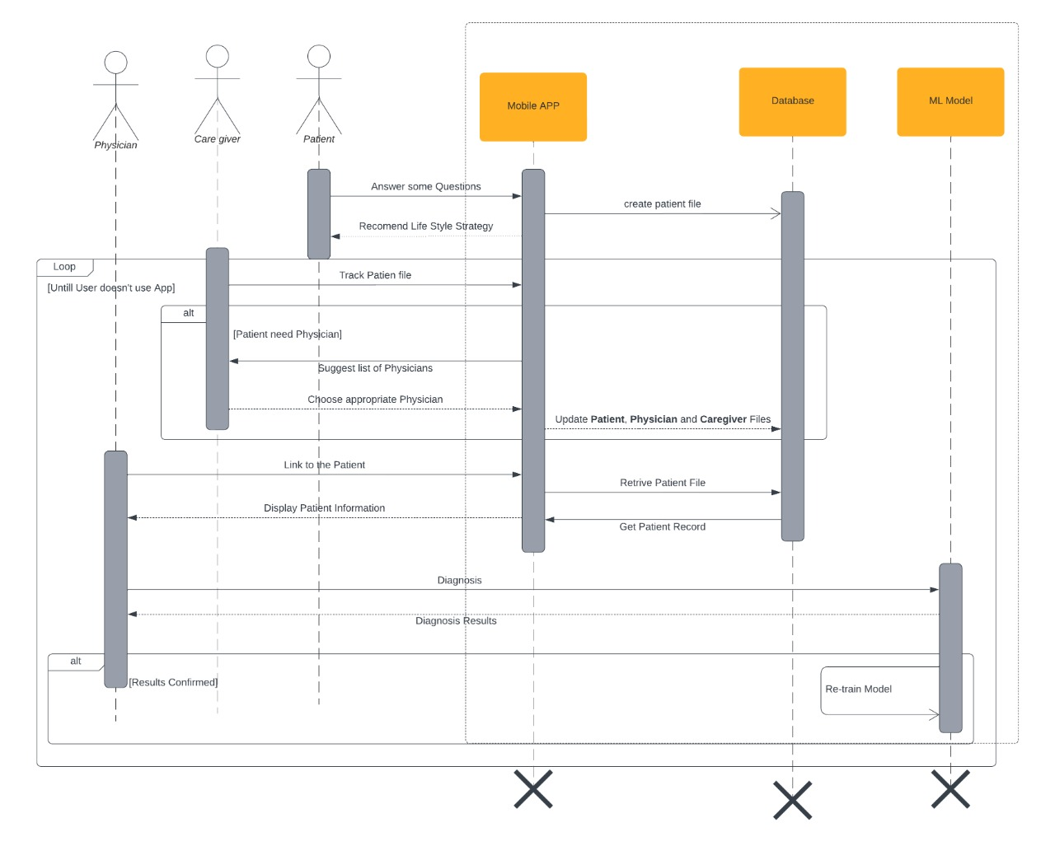
—Sequence Diagram

Slide 25
07.
Mobile app

Slide 26
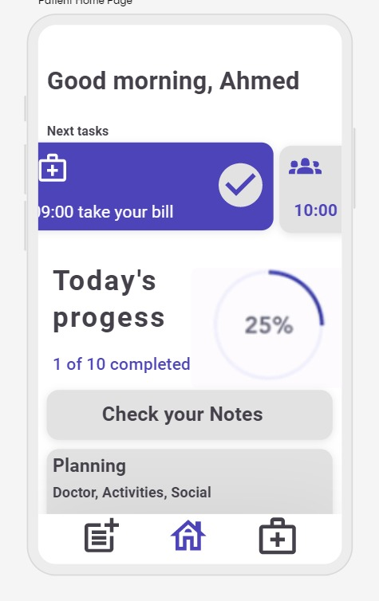

Slide 27
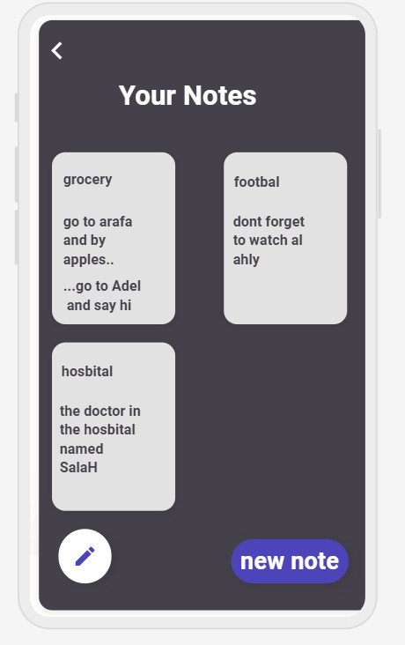

Slide 28
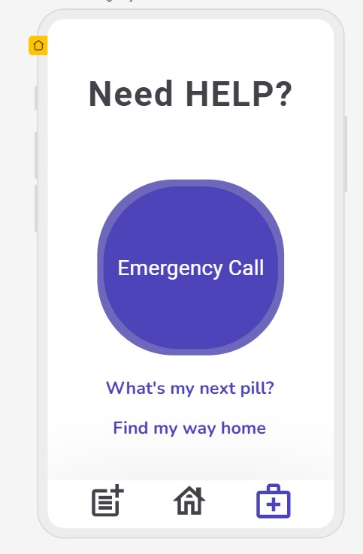

Slide 29
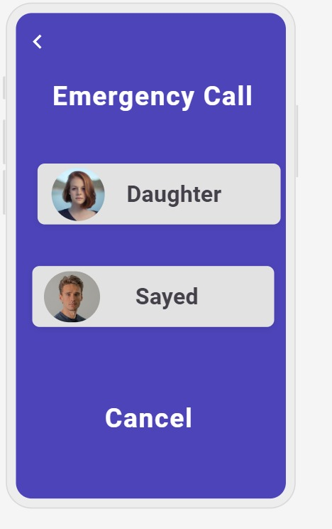

Slide 30
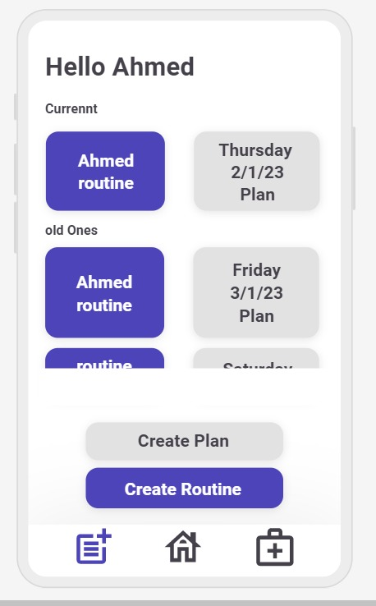

Slide 31
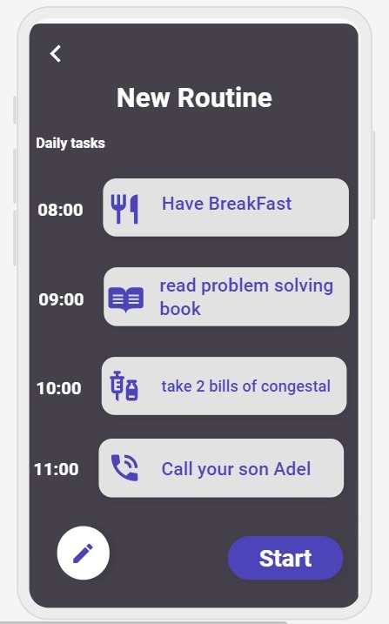

Slide 32
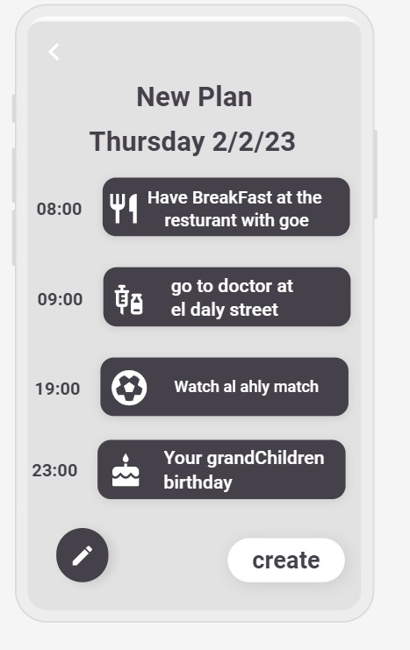

Slide 33
OUR Team
Yasmeen Saad
Mohamed Ashraf
Shrouk Nasser
Sameul Adel
Mohamed Yasser

Slide 34
THANKS!

